Slide 1


Capstone Project
The Battle of Neighborhoods

Slide 2
Outline
Introduction
Business Problem
Target Audience
Data Description
Results
Discussion
Conclusion

Slide 3
Introduction
As part of Applied Data Science Capstone, this project encompasses the core concepts learned in the Coursera-IBM Data Science Professional Certificate Course.
This project employed techniques like
Data Acquisition
Data Cleaning,
Data Visualization
Data Analysis
Geocoder
Folium
Foursquare
K-means Clustering Algorithm

Slide 4
Business Problem
Toronto, the capital of the province of Ontario, is one of the major Canadian cities
Being a dynamic metropolis, it attracts people from multi-ethnic groups, consequently it is not only the most densely populated region of the Canada but also provides numerous growth opportunities
In this context, the food business is one of the promising sectors to invest, as being a multicultural city, Toronto offers wide range of cuisines.
To invest in the food business, this project aims to identify the best venue to open a restaurant that offers continental food, not only to better serve the community but also provide an edge to flourish the business.

Slide 5
Target Audience
The targeting audiences of this project are entrepreneurs and community members.
As from the best location/venue of the continental restaurant
The entrepreneurs can benefit in terms of more profit from their business. On the other side, the best location of the continental restaurant will also facilitate the community members.

Slide 6
Data Description
As Toronto being the intended city to open the continental-food restaurant, the postal code data of Toronto is acquired from Wikipedia (the web-link to the acquired data is provided as, https://en.wikipedia.org/wiki/List_of_postal_codes_of_Canada:_M).
The acquired data is transformed to pandas dataframe for further processing. The extracted dataframe consist of 3 columns namely, Postal Codes, Borough, and Neighborhood, which are further cleaned for further visualization and analysis.
The geographical coordinates of each postal code are obtained from https://cocl.us/Geospatial_data. Moreover, Geocoder and Foursquare are also employed in this project for visualizing and pertaining the venue data for geographical location suitability.

Slide 7
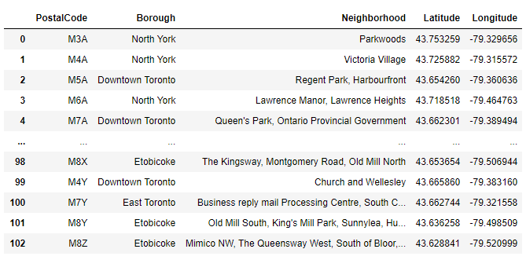
Cont. Data Description

Slide 8
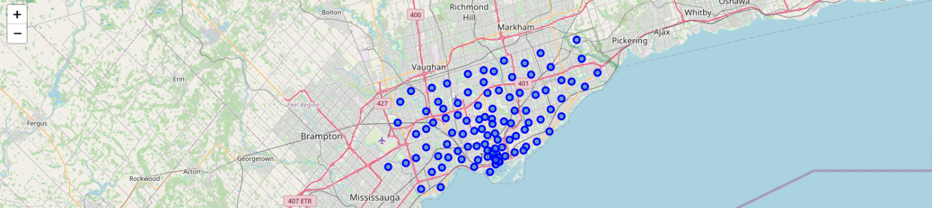
Results
The acquired data is cleaned and geospatially analysed in the context of the neighborhoods in Toronto.

Slide 9
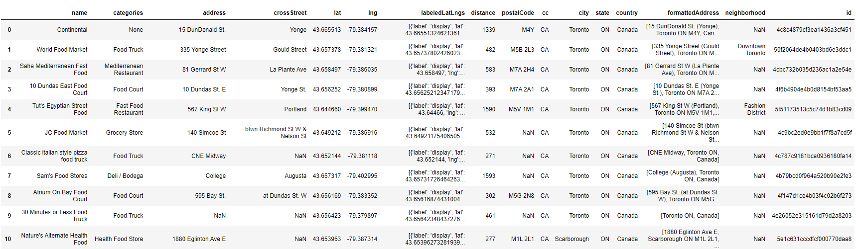
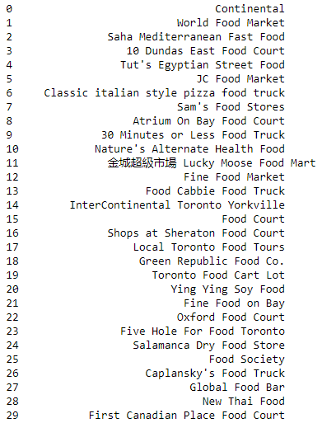
Cont. Results
Foursquare API is employed to search for existing continental food restaurant and the existing restaurant are mapped on the geographical map to extract their locations.
For said purposes the extracted data related to continental food is thoroughly cleaned for further processing.

Slide 10
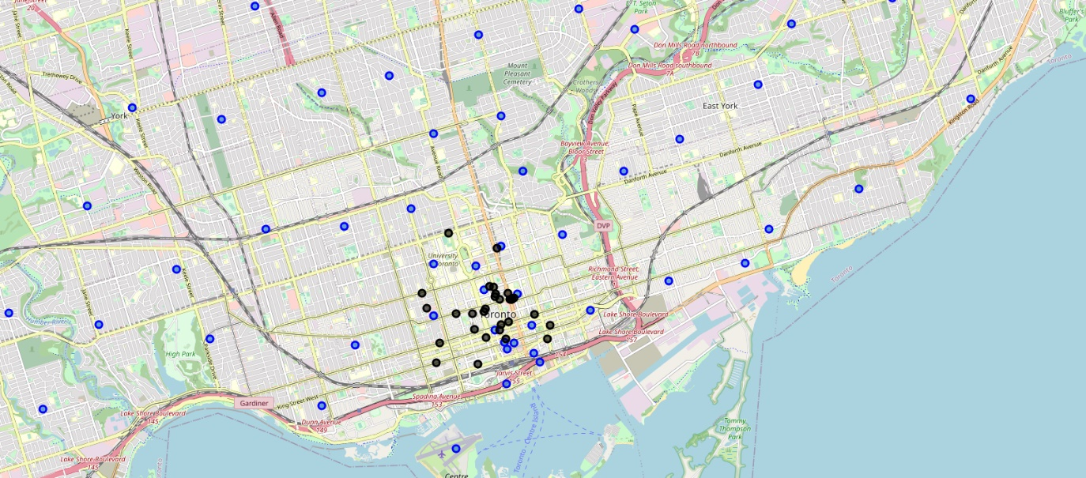
Cont. Results
The existing restaurants are also mapped along with the postal codes to better visualize the existing of the restaurants against different locations.

Slide 11
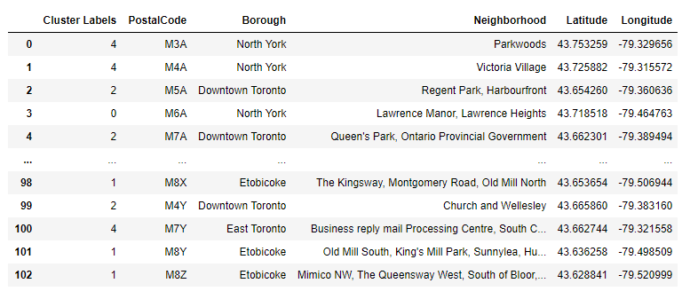
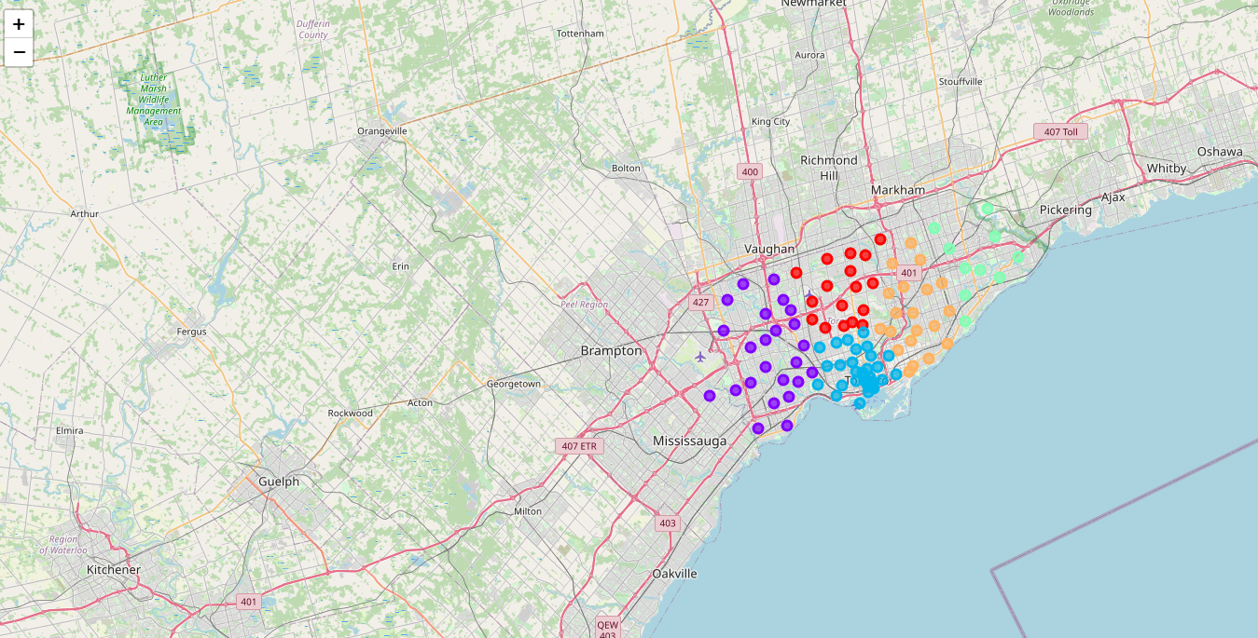
Cont. Results
The neighborhoods. are also clustered using k-means algorithm

Slide 12
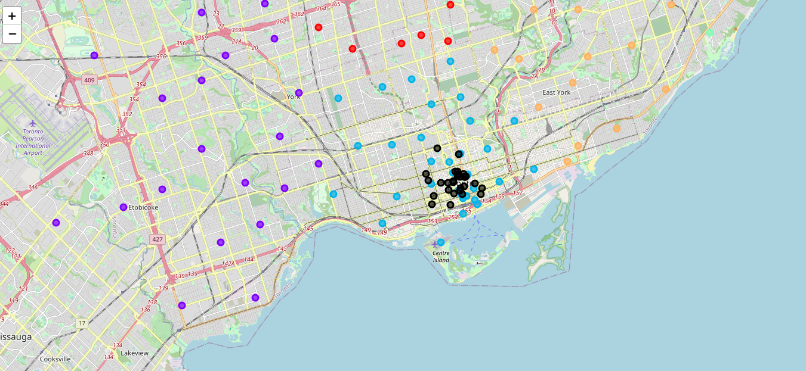
Cont. Results
The clustering information is also mapped against the location of the restaurants offering continental food in Toronto.

Slide 13
Conclusion
It is observed from the extracted results, under given conditions, that all the continental food restaurants are in cluster 2 (presented in light blue color in figure on previous slide), where clusters 0, 1, 3, and 4 does not have any restaurant that offers continental food.
Hence for opening a new restaurant that offers continental food, it is better to invest in the regions that lies in clusters 0, 1, 3, and 4.
Moreover, even within cluster 2 there are locations (as seen in previous figure on previous slide) that possess potential for opening a restaurant offering continental food.

